Slide 1
The Systems of Provision Approach: Who gets what, how and why Kate Bayliss University of Sussex and SOAS, University of London

Slide 2
Outline
What is the SoP approach?
What are the core elements?
Examples of SoP case studies
Conclusion – why use the SoP approach

Slide 3
What is the SoP approach?
Developed by Ben Fine and Ellen Leopold in 1990s.
A framework for understanding the messy realities of the drivers of consumption outcomes.
In part a reaction against the failings of neoclassical economics to adequately explain consumption.
Turned to other social sciences – anthropology, sociology, psychology.
Core premise – consumption linked to production in a vertically integrated system.

Slide 4
Core SoP elements
Agents
Structures
Processes
Relations
Material cultures
And specificity and context are key!

Slide 5
Doing SoP research
SoP is an approach, not a methodology.
Mixed research methods.
Inductive approach.
Research will not follow a linear path.
Setting of SoP boundaries will also be inductive, depending on area of interest and available resources.

Slide 6
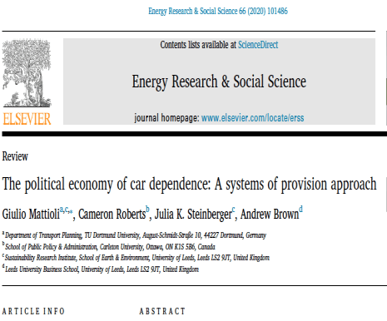
The commodity itself shapes production and consumption.
Agents - Car producers have political clout.
Agents – Strong state support for car use.
Across political spectrum supporting car ownership seen as common sense.
Structures of land use promote vehicle ownership.
Material cultures – cars are associated with far more than basic function.
Their SoP study exposes a
“deeply self-reinforcing system, apparently immune from economic and political pendulum swings, able to bend the forces that sway the rest of the society to its purpose.”

Slide 7
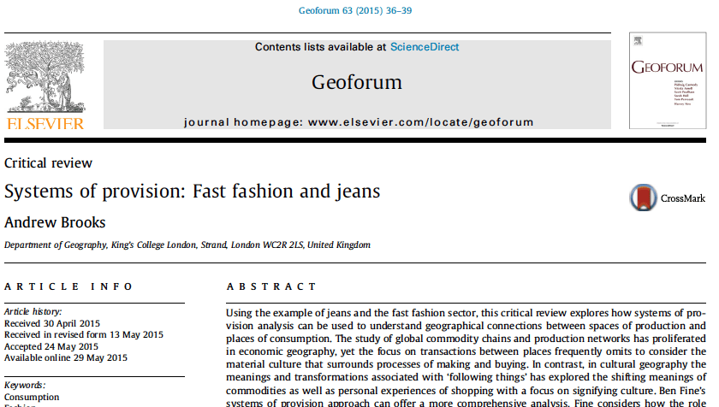
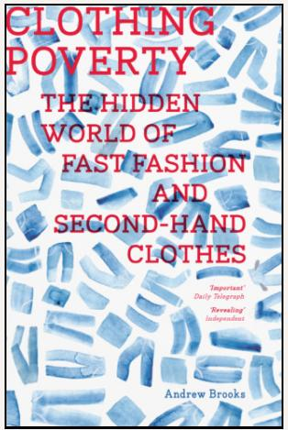

Slide 8
Fast fashion and clothing poverty SoP
Agents – agricultural workers, manufacturers, retailers, designers, advertisers, company shareholders – spatially segregated.
Structures - unequal structures of clothing production are embedded in relations and engagement in international trade that date back to the colonial era.
Material cultures – pressure to overconsume fast fashion ➔ vast surplus.
“Rich consumers around the world enjoy a great range of clothes, but sadly are complicit in a process that locks many of the world’s poor in Africa, Asia and Latin America into a partial dependency on second-hand clothing imports.”
Ethical consumption - capitalism’s “elegant solution” to the criticisms raised - can be used to further “embed the logic of inequality.”

Slide 9
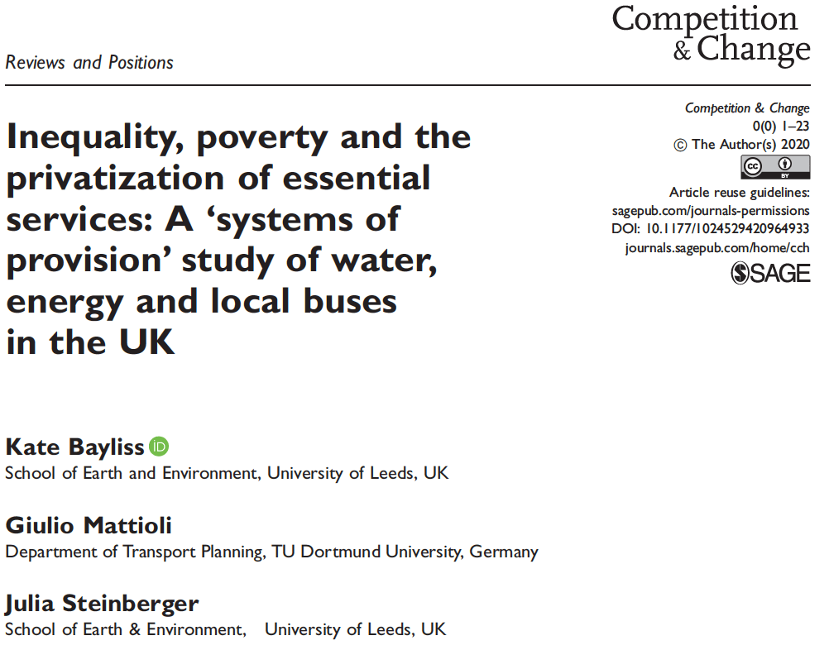

Slide 10
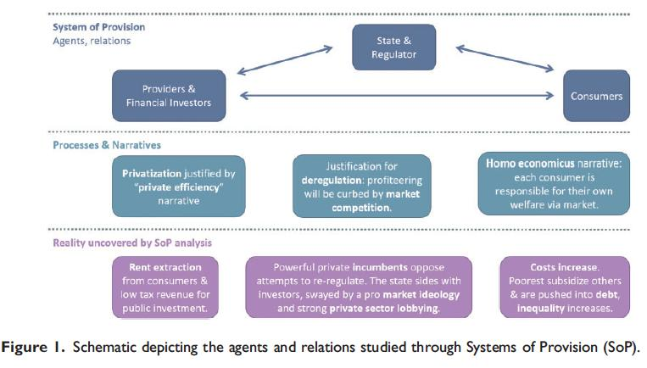

Slide 11
To conclude – why use the SoP approach?
SoP offers an innovative real-world way of understanding consumption (and other) outcomes, lifting the lid on the underlying social relations.
Goes beyond superficial indicators to unpack the real world complexities that sustain specific outcomes – the prevailing narratives and cultures, the common senses that create and perpetuate systems.
Joins up segments that are treated separately – moves the focus from the individual to the system.
Identifies leverage points for change.

Slide 12
Thank you!
kb6@soas.ac.uk

