Slide 1
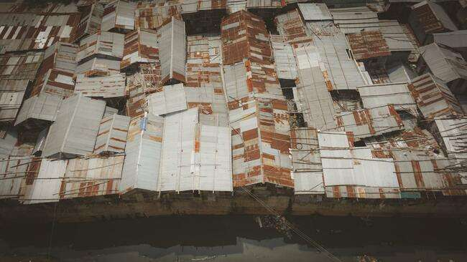
The Unknown City: urban displacement and the impact of the pandemic
Mike Collyer (University of Sussex) and Laura Hammond (SOAS University of London)

Slide 2
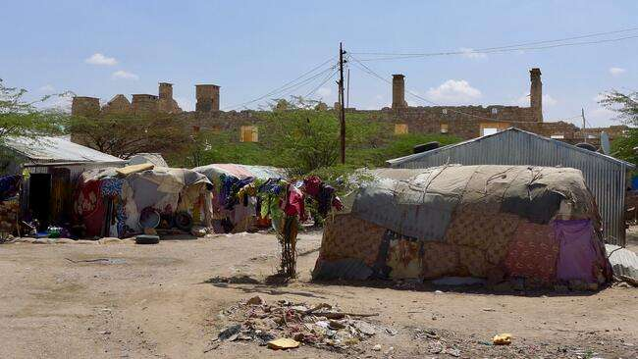
State House, Hargeisa

Slide 3
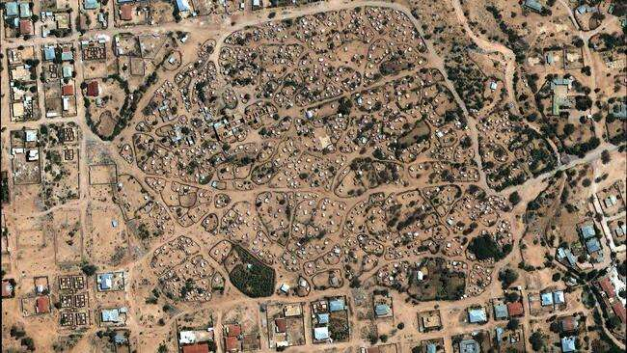
State House, Hargeisa 2002

Slide 4
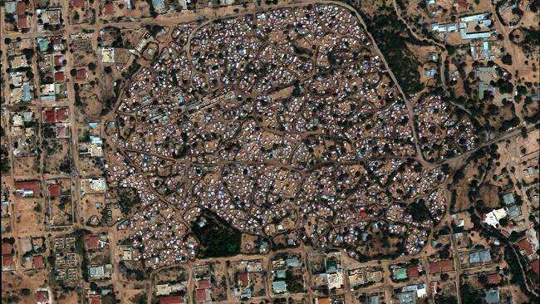
State House, Hargeisa 2008

Slide 5
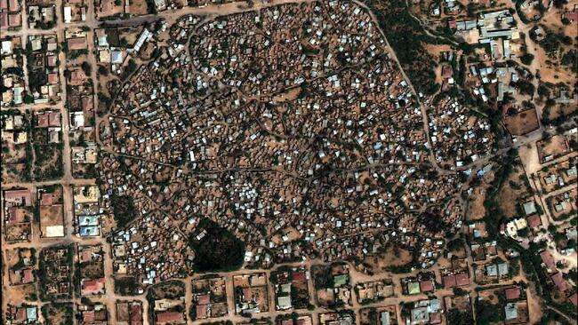
State House, Hargeisa 2014

Slide 6
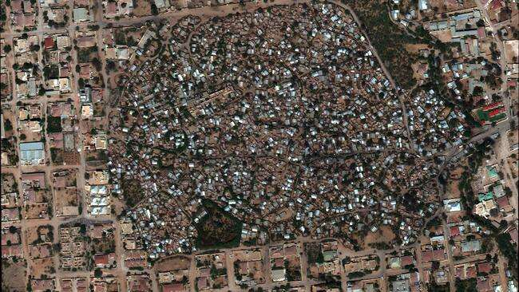
State House, Hargeisa 2018

Slide 7
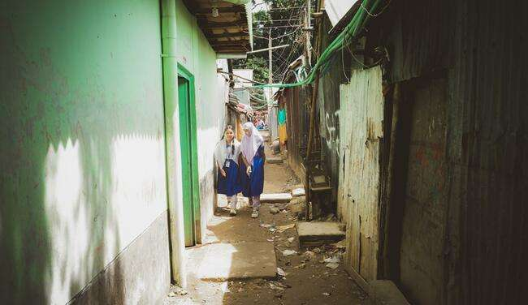
Ershadnagar, Dhaka

Slide 8
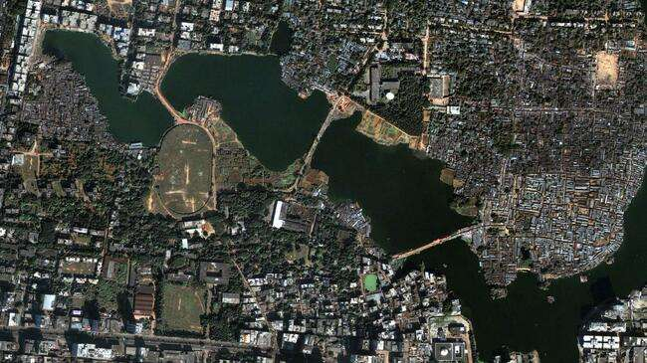
Ershadnagar, Dhaka 2004

Slide 9
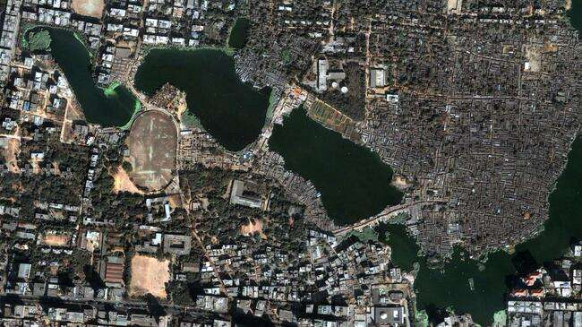
Ershadnagar, Dhaka 2010

Slide 10
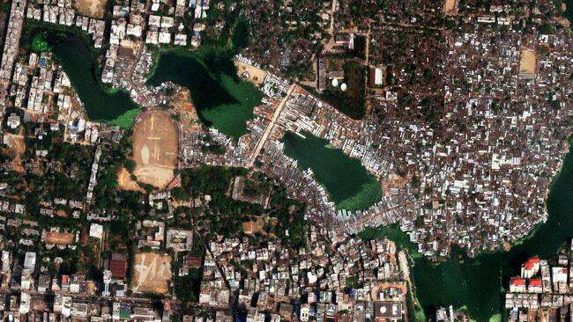
Ershadnagar, Dhaka 2014

Slide 11
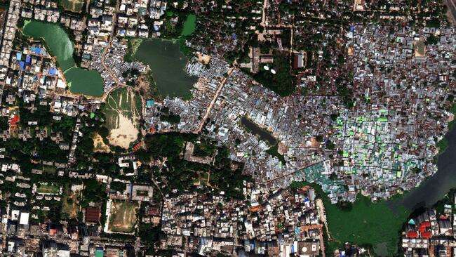
Ershadnagar, Dhaka 2018

Slide 12
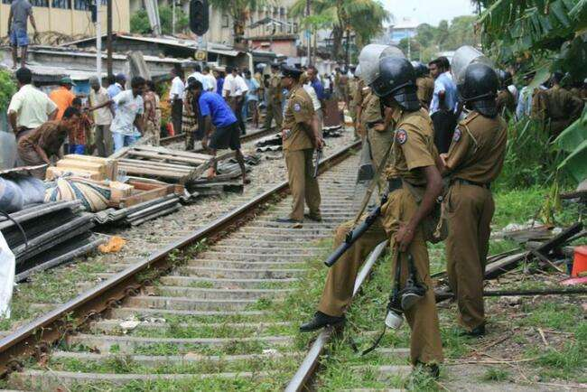
83% of governments reported concerns about patterns of population distribution. 72% developing countries have policies to reduce migration to large cities
Notes:
From World Population Policies 2009. Governments in Africa and Asia most likely to report desire to change spatial distribution of populations. 75% in Africa and 57% in Asia desired major change. Only 34% of developing countries have policies to reduce rural to urban migration.

Slide 13
What did we want to find out?
What are the factors behind the persistence of urban poverty and how is this linked to mobility? Do individuals become trapped on moving to cities?
How do forced migrants plan their everyday mobility and select residential and work locations within urban areas? What is the relationship between mobility and place?
How can arrival be supported in sustainable ways to improve poverty reduction?

Slide 14
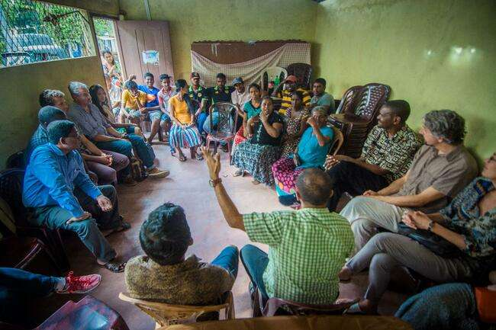
Stakeholder engagement

Slide 15
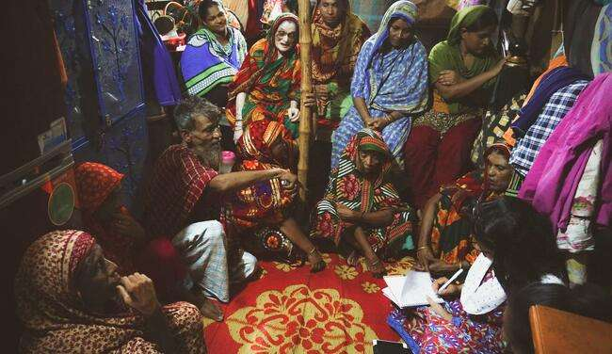
Focus group discussions
This place is too crowded for me to live here happily
This place has a good reputation
I am living here as I have no alternative
United, we have the power to stop eviction

Slide 16
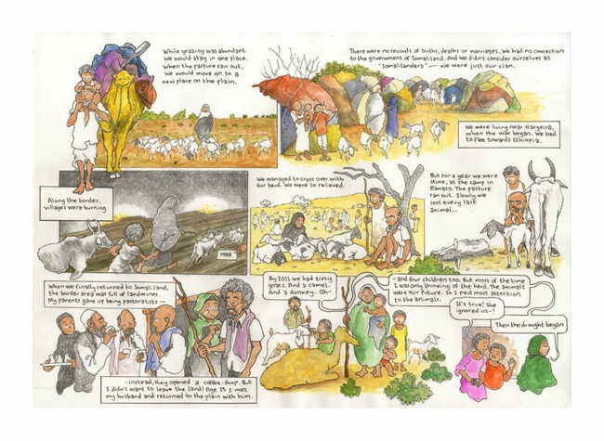

Slide 17
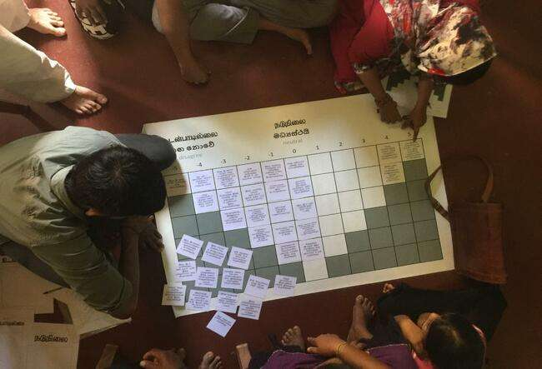
Q Method

Slide 18
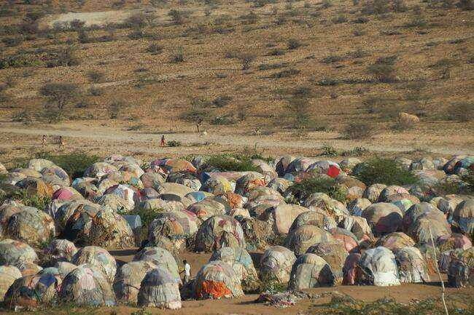
What did we find?

Slide 19
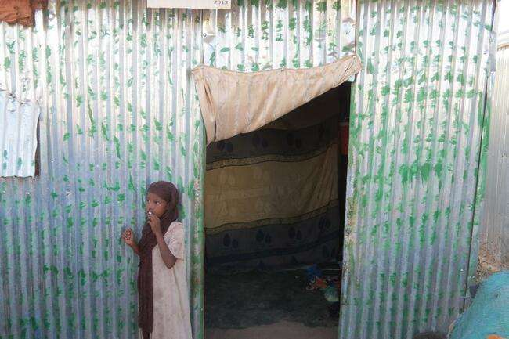
Security of Tenure is the Most Pressing Concern in All Areas

Slide 20
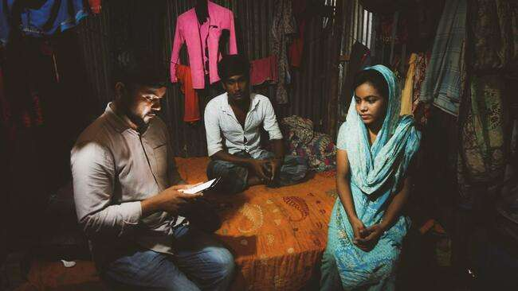
Fear of Destitution and Eviction

Slide 21
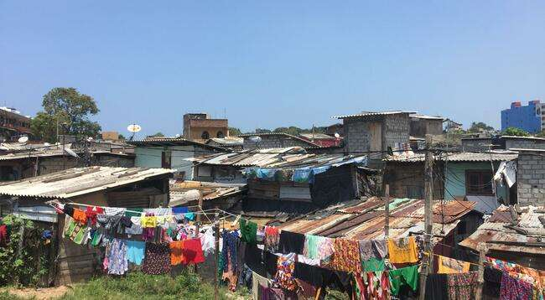
Trapped Populations

Slide 23
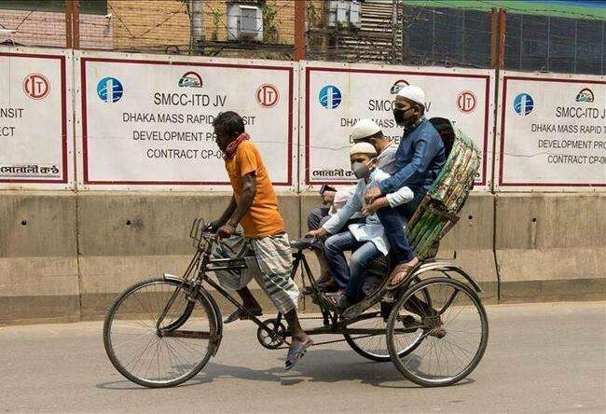
Implications of COVID-19
Crowded communities, shortage of drinking/washing water, food
Insecure employment
Drop in remittances
Movement restrictions
Inaccessibility of health care and testing facilities
People feel unable to take precautions against COVID-19
Photo: Anadolu Agency

Slide 24
How can we use Anthropology and Geography to prepare for and respond to health crises?
Data from studies like MOTM show how people living on the margins respond to shocks, what resources they have, what their priorities are
Longitudinal study can inform how people are likely to respond, what their challenges will be
Mobility is key to the strategies of people on the margins; restricting movement is unlikely to be effective in mid- to long-term

Slide 25
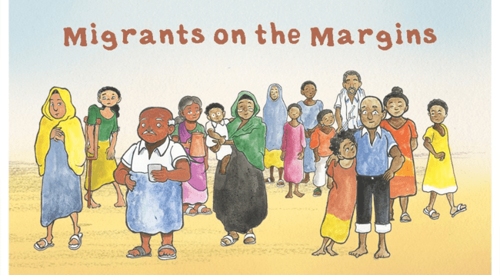
Thank you!!
Artwork: Positive Negatives

